Slide 1
Happy hour app
Team Enterprise - Group member:
Obiechi Samuel Ebuka - 195471
Gulam Mohiuddin Abdul Qader -195461
Shohiduzzaman Shakil - 195674
Muhammad Haziq Farhan bin Mohd Lip - 195988

Slide 2
Introduction
Our app introduces a new way for delivering gifts to the user from nearby shops
For a certain shops, they would distribute gifts to the user whenever the user want to claim a reward when they fulfill the criteria.
This app utilizes the robotic technology as well as mobile phones location services in order to automate the delivery task.

Slide 3

Customer send request
Register
Login

Slide 4
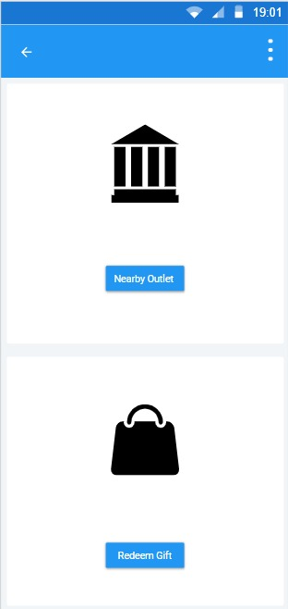
Customer homepage
Redeem Gift
Redeem Gift

Slide 5
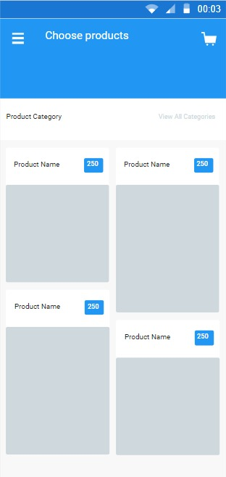
Select gift
Choose product based on available points.

Slide 6
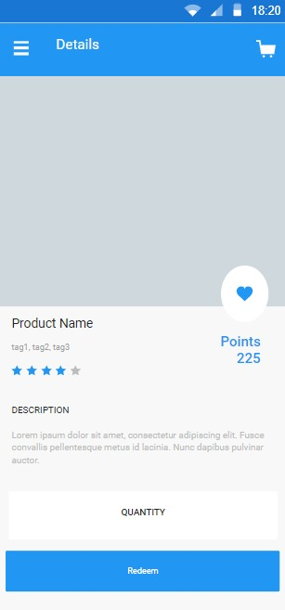
Gift details
When the user clicked on the gift, The details about the gift is displayed

Slide 7
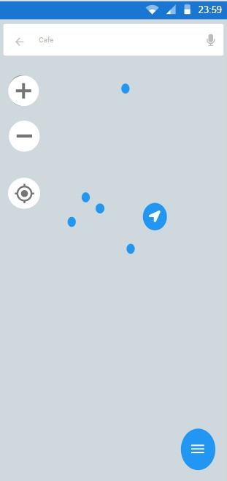
Location
Used to locate nearby outlets to do a delivery.

Slide 8

Request received

Slide 9
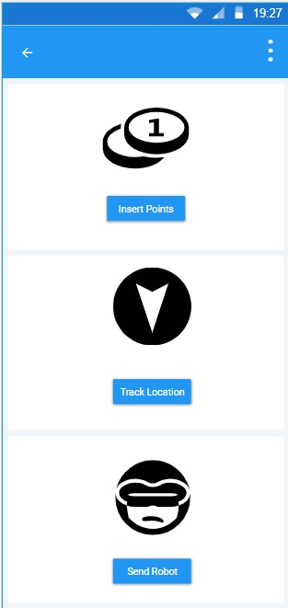
Admin homepage
When admin or staff open the system, their customized user interface will appear.

Slide 10
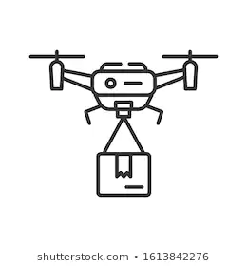
Sending gifts

Slide 11

Gift received

Slide 12


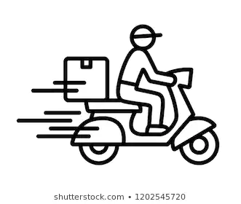
Advantages
Making delivery task easier and safer during pandemic
Giving a new way to serve customer
Faster delivery

Slide 13
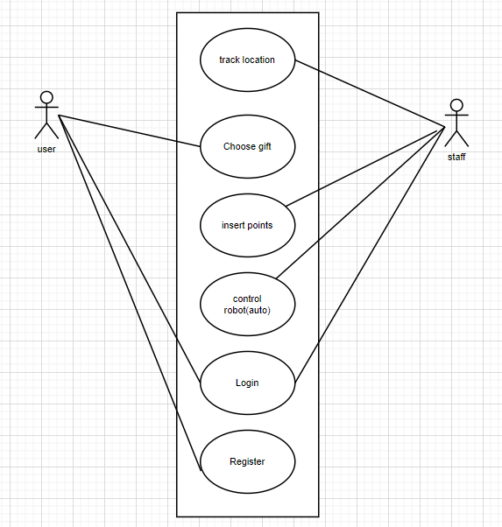
Use-case diagram

Slide 14
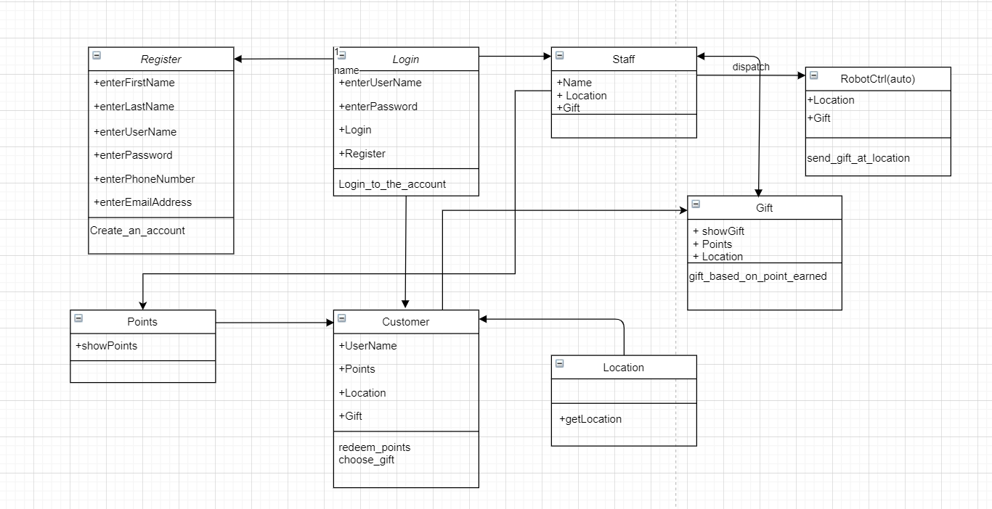
Object Oriented Class Diagram
Object Oriented Class Diagram of Happy hour app.

Slide 15
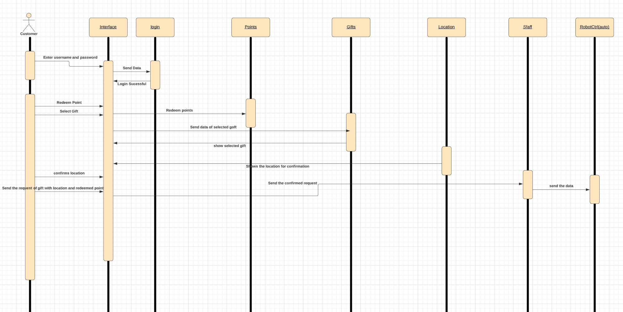
Sequence Diagram

Slide 16
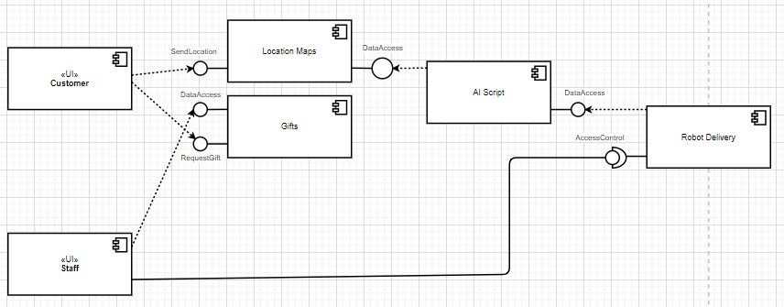
Component Diagram

Slide 17
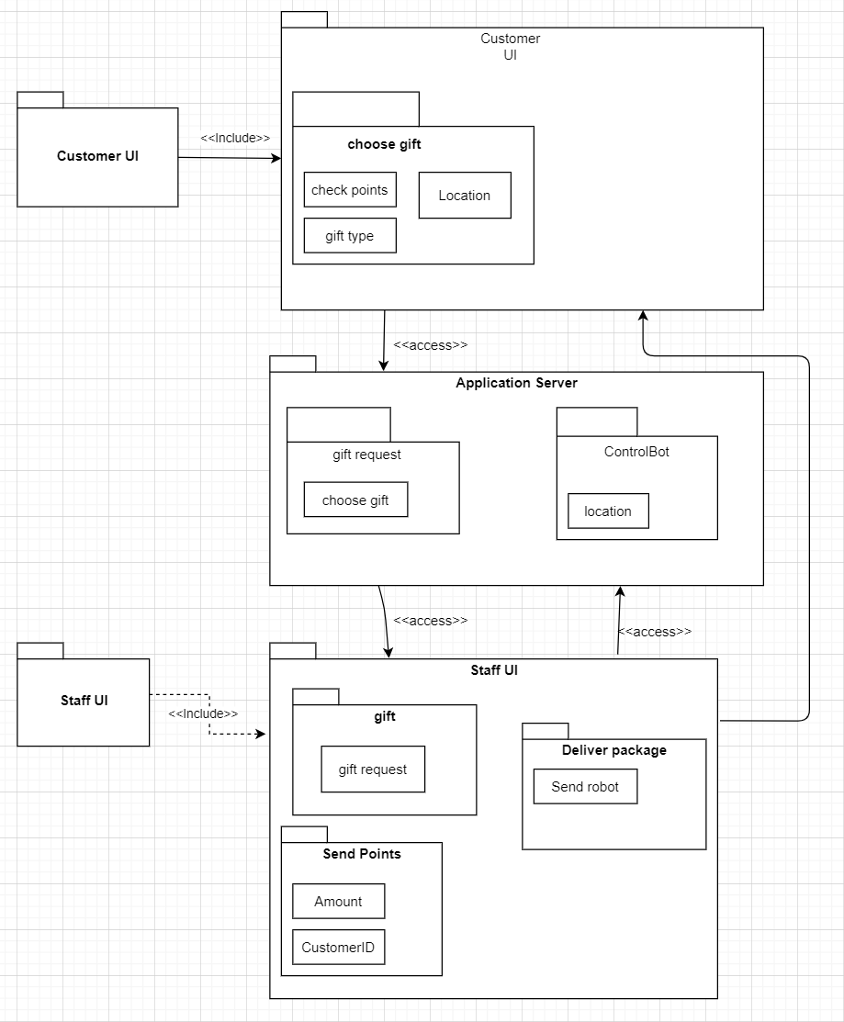
Package Diagram

Slide 18
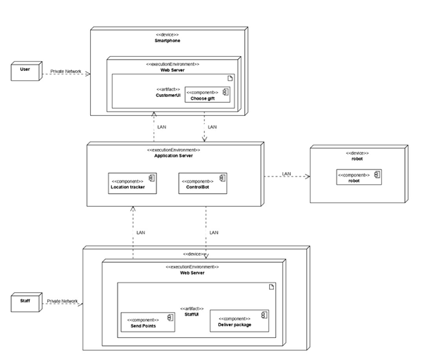
Deployment Diagram

Slide 19
Thank you

